Slide 1
Computing Trend Presentation For class CS605-741 Research Methods 307020 on Data Analytics By Kaveri Hari Charan Yadav
Submitted To
Dr. Sumanth Yenduri
Department of Computer Science
Southeast Missouri State University
Cape Girardeau, Missouri 63701
May 2019

Slide 2
Contents
Introduction
Relevance
Motivation
Applications
Future Growth
Your Overall Assessment
Conclusions
References

Slide 3

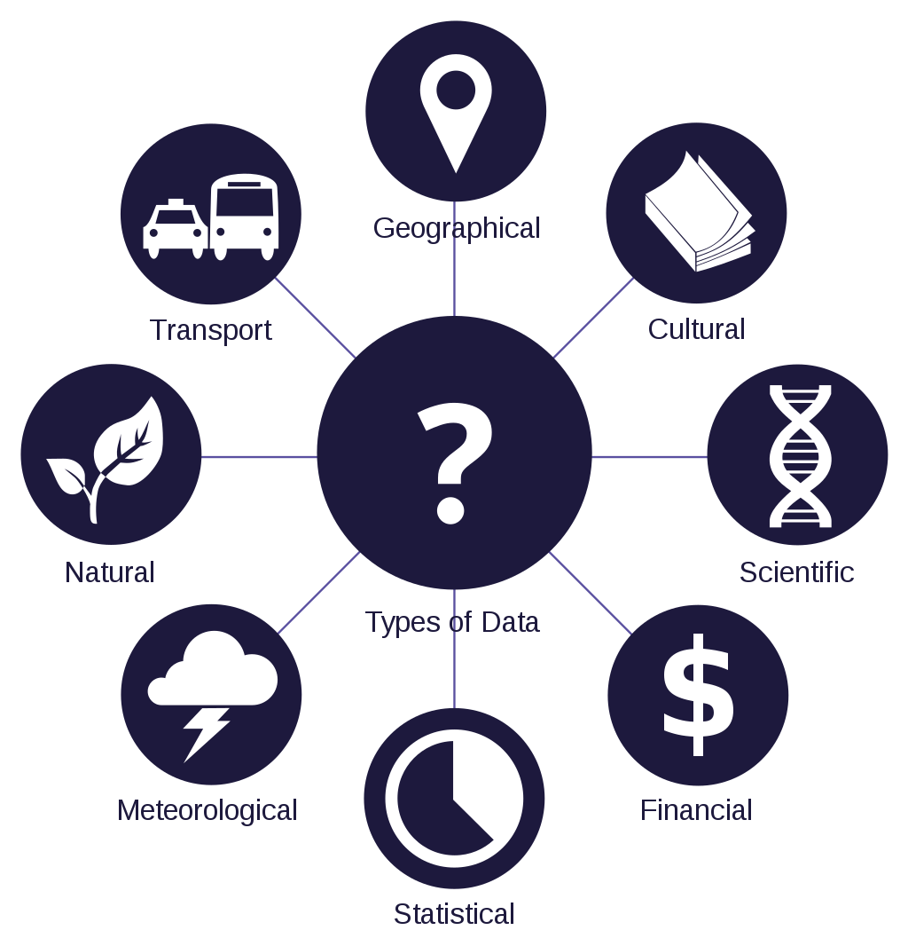
Introduction
Data : in computing, data is information that has been translated into a form that is efficient for movement or processing.
Data types:
i)Quantitative data : ex: numbers, statistics
ii)Qualitative data: ex: words, objects, images
In Computing data is in binary form i.e. 0 /1.
Analytics: is the discovery, interpretation, and communication
of meaningful patterns in data.
Decision Making
Especially valuable in areas rich with recorded information, analytics relies on the simultaneous application of statistics, computer programming and operations research to quantify performance.
Describe, predict, and improve business performance.

Slide 4
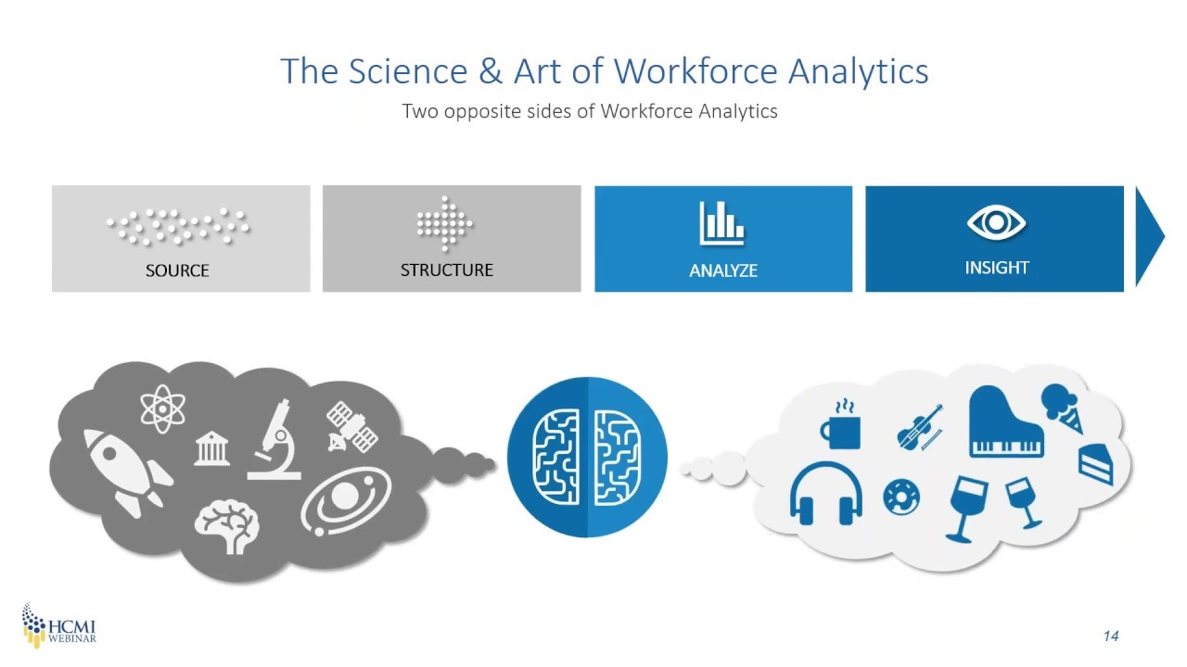
Analysis vs Analytics
Analysis is focused on understanding the past; what happened. Analytics focuses on why it happened and what will happen next.

Slide 5

Data Analytics Data analytics is the science of analyzing raw data in order to make conclusions about that information

Slide 6
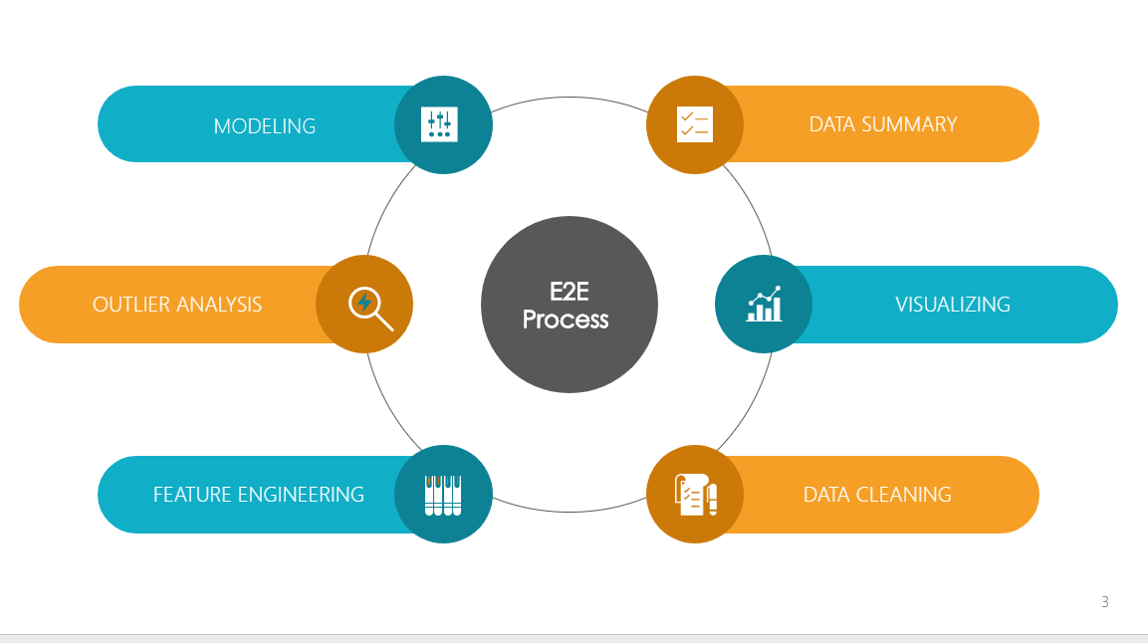
Data Analytics Process
Data analytics is a broad term that encompasses many diverse types of data analysis.
Any type of information can be subjected to data analytics techniques to get insight that can be used to improve things.
For example, manufacturing companies

Slide 7
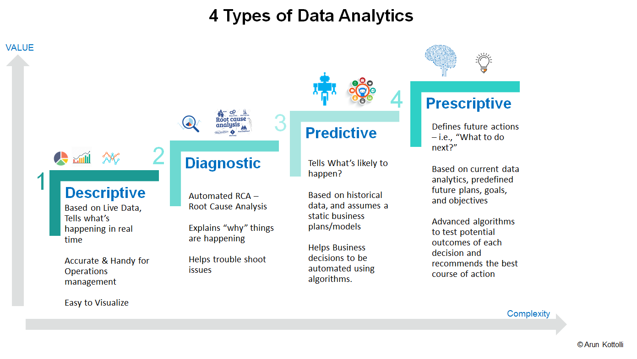
Analytics Types

Slide 8
Relevance
History of Analytics
The use of Analytics by business can be found as far back as the 19th century
Database and data warehouse.
The practice of Data Analytics has gradually evolved and broadened over time, providing many benefits.

Slide 9
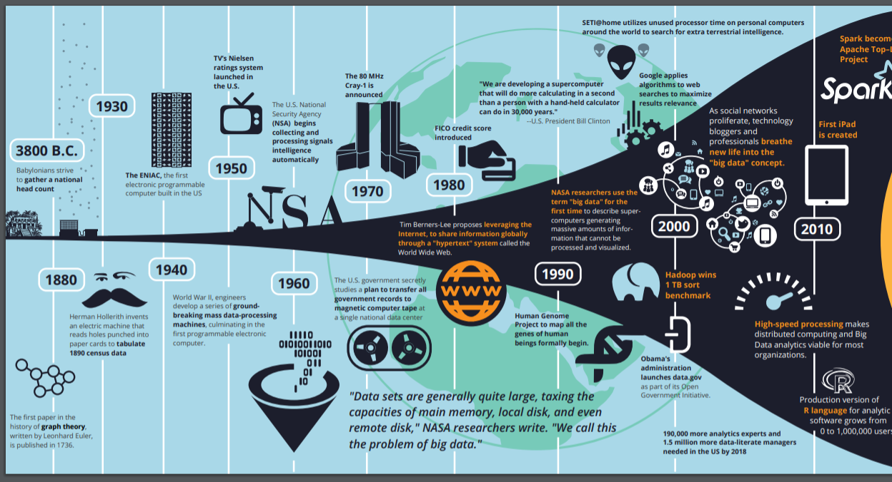
History

Slide 10
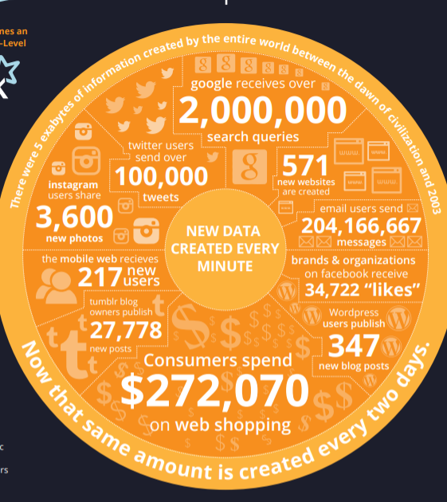
Motivation
Faster, better decision making
New products and services
Data source generating

Slide 11

Applications
Transportation
Healthcare
Weather
E- commerce
Banking
Finance
sports

Slide 12
Transportation
Trucking Industry
Railroad Industry
Air Cargo Industry

Slide 13
Healthcare
Hospital Management
Patient Records
Costs
Diagnoses and more.

Slide 14
Weather
Climatic conditions
Different locations
Change minute to minute

Slide 15
E- commerce
No. of visitors
No. of purchases
No. of brands

Slide 16
Banking
Use of credit or debit
No. of transactions
Credit score

Slide 17
Finance
Stock Markets
Business Shares

Slide 18
Sports
Game Overview
Players View
Opponents Behavior

Slide 19
Future Growth
As advancements in the field of data analytics are being made, the process is getting automated.
Machines are analyzing big chunks of data in an automated process. With more and more smart machines entering our daily lives, more and more data is getting created every hour.
All this data can be used and analyzed for understanding customer behavior or predicting future trends. With the help of machines, data analysts are finding it possible to make sense of the data in a quicker and easier way.

Slide 20

Your Overall Assessment
Data Analytics is leveraging the data in order to help organization growth.

Slide 21
Conclusion
Data analytics provides both speed and accuracy to business decisions.
It is preparing the companies to make products for the future and aspire to connect with the customers of tomorrow.

Slide 22
References
https://ieeexplore.ieee.org/document/8070723
https://www.dataversity.net/brief-history-analytics/
https://ieeexplore.ieee.org/stamp/stamp.jsp?tp=&arnumber=8698814
https://www.flydata.com/blog/a-brief-history-of-data-analysis/
https://www.digitalvidya.com/blog/data-analytics-applications/

Slide 23
Questions?

Slide 24

Thank You

